Slide 1
By Kapil Marwaha (Team TrueData)
www.truedata.in

Slide 2
Topics being addressed today
Introduction of FYERS API TrueData
What is TrueData Option Decoder
How to Login TrueData Option Decoder
Brief overview of TrueData Option Decoder & its various features
How to log in Fyers from TrueData Option Decoder
Special Benefits for Fyers client through TrueData Options Decoder
Why TrueData Option Decoder is different from another competitors

Slide 3
FYERS is already partnered with TrueData for API services.
Now FYERS is also integrated with TrueData for Options Decoder.

Slide 4
TrueData Options Decoder

Slide 5
What is TrueData Options Decoder?
A feature rich real-time Option and Future analysis application with Live option chains, Strategy Analyzers, Implied volatility & Open interest and much more.
Real-time 2 seconds update.
Single data fetch for all options page.
Index spot prices are displayed on all pages.
User friendly, fast and light and dark themes.

Slide 6
How to Login TrueData Options Decoder
Step1> Please visit TrueData Options Decoder to register yourself or visit Pricing Page to >>(https://options-decoder.truedata.in/login)
Step2> After you register successfully, you would receive an email verification link sent to your email address to get your account activated .

Slide 7
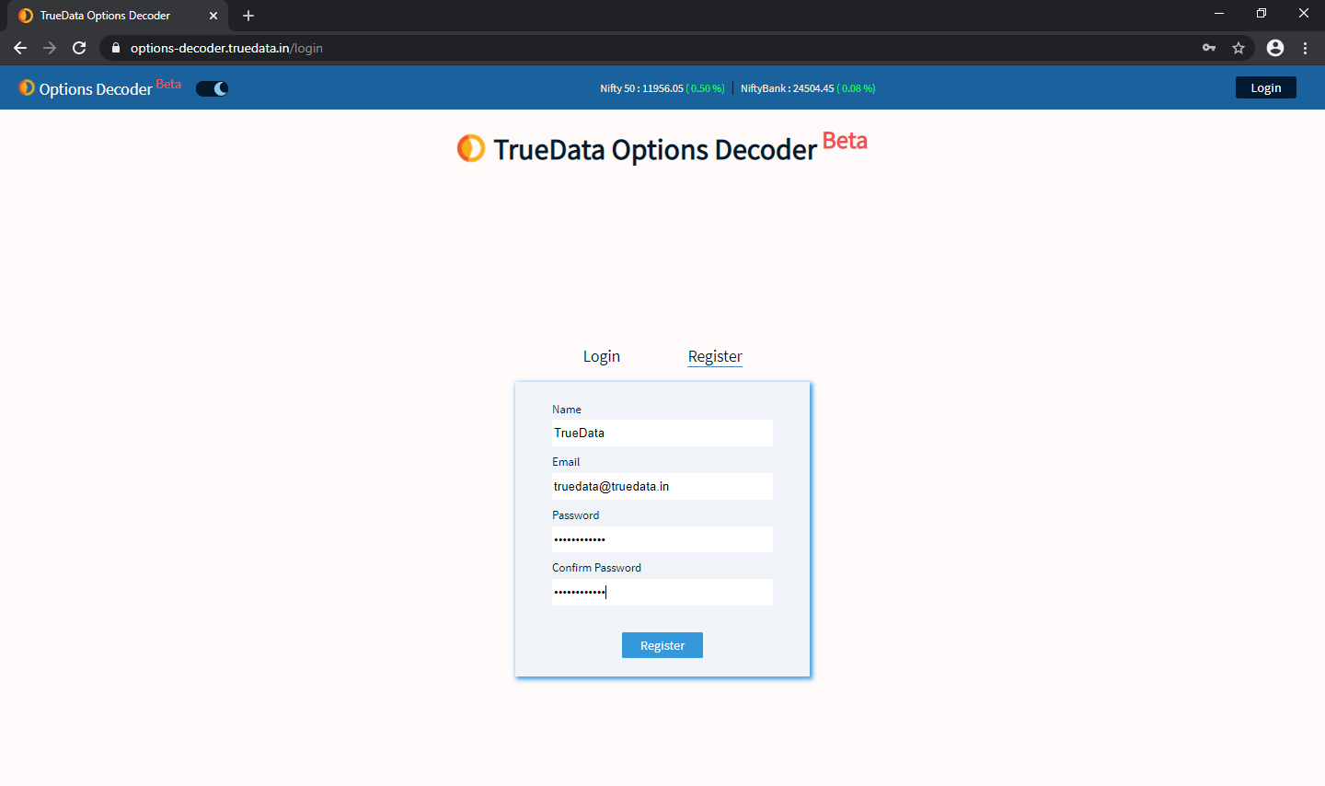

Slide 8
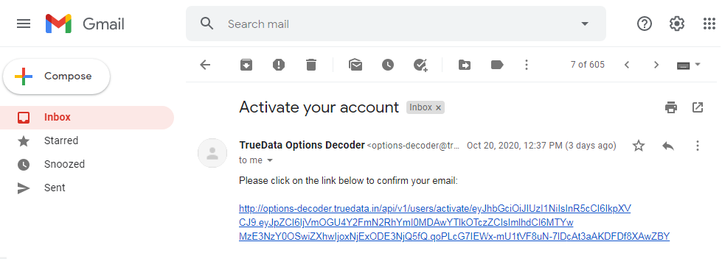

Slide 9
Brief Overview of TrueData Option Decoder and its various features
Option Chain
OI Graph
OI Change
Option Analysis
PE-CE Difference
Multi-Strike chart
IV-Price-OI Chart
Straddle/ Strangle
Strategy Builder
Strategy Analyzer
Futures Analysis
Futures Chart
Top futures
Advance/ Decline
Watch List
HV-IV

Slide 10
Option Chain
Option Chain has two sections calls on the left and puts on the right.
In the middle of the table you can see all the available strikes in ascending or descending order
On both sides of the strike prices, we have “LTP, Net Change, IV, Volume, OI, Change in OI, Analysis.”

Slide 11
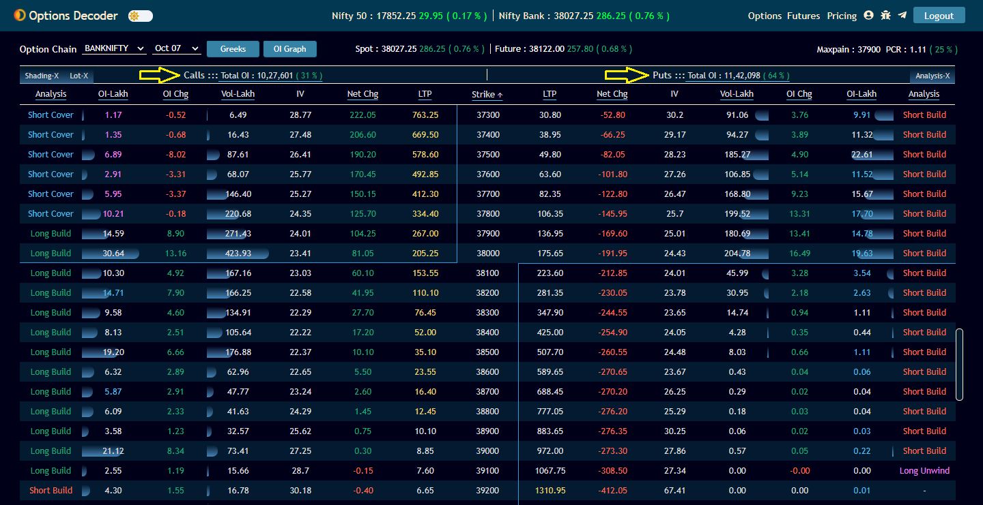

Slide 12
How to analyze an Option Chain
Using Option Chain we can identify areas of support and resistance.
Most of the option writing is done by professionals and big institutions.
Buyers is usually a retail trader.
Large OI means massive bet against that strike.

Slide 13
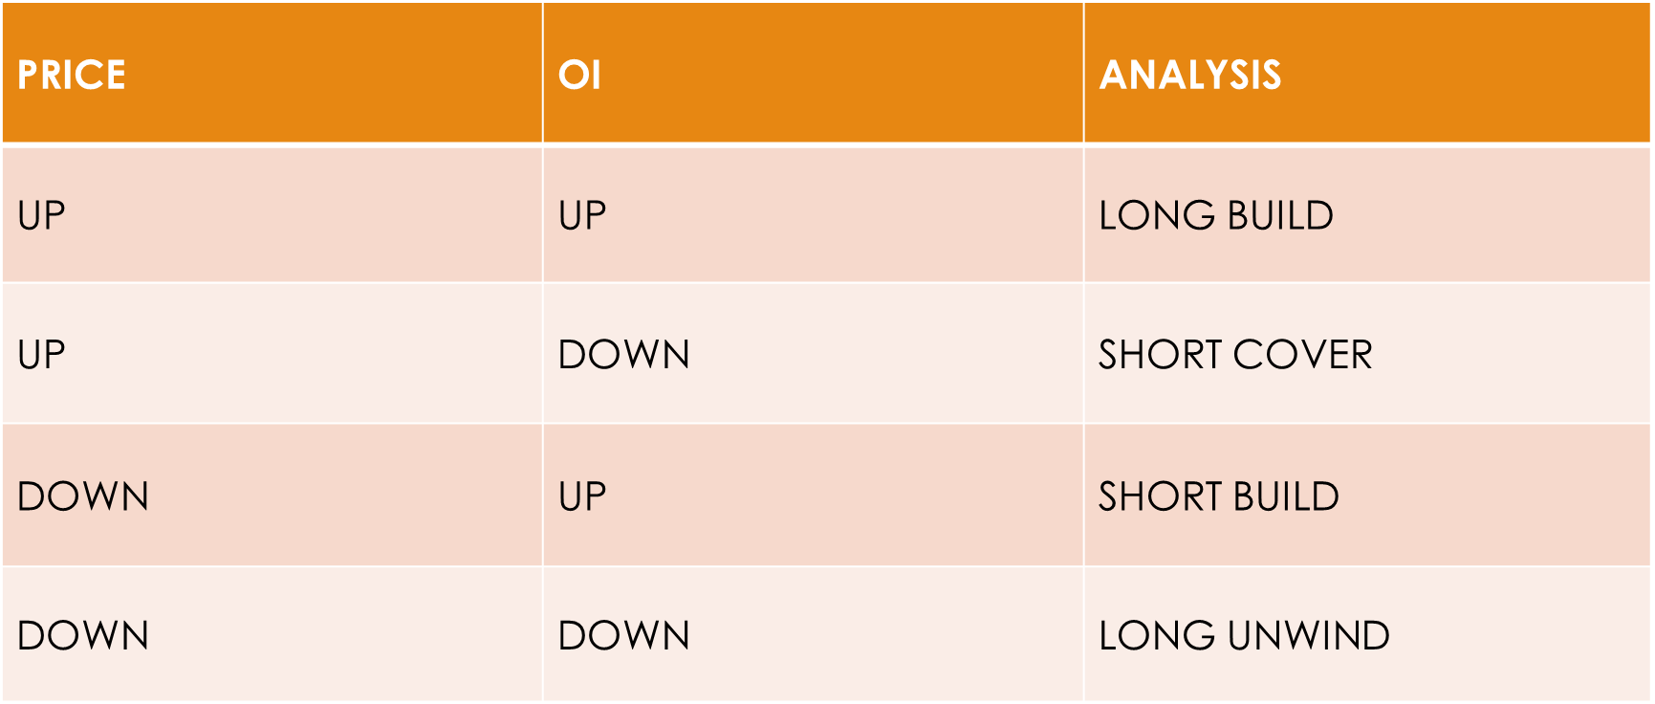

Slide 14
PCR & MAXPAIN
PCR denotes Put Call Ratio. It is the ratio of put and call open interest
If the ratio is higher than 1- traders are selling more Puts than Calls - bullish.
Low PCR – bearish
Maxpain is the level where market is likely to expire. Expiry happens at a level where there is least damage to sellers.

Slide 16
OI Graph
4 values in single bar - Previous oi - blue color, current oi - green color, high oi - faded green and low oi – red.
Blue shaded portion shows previous day's oi. From previous oi, today if oi is increased, green color shows that % increase.
Faded green shows that it has gone to that much high at some point ,came back to where the current oi is now.
Low oi- at some point oi went to that much low and then went to current oi

Slide 17
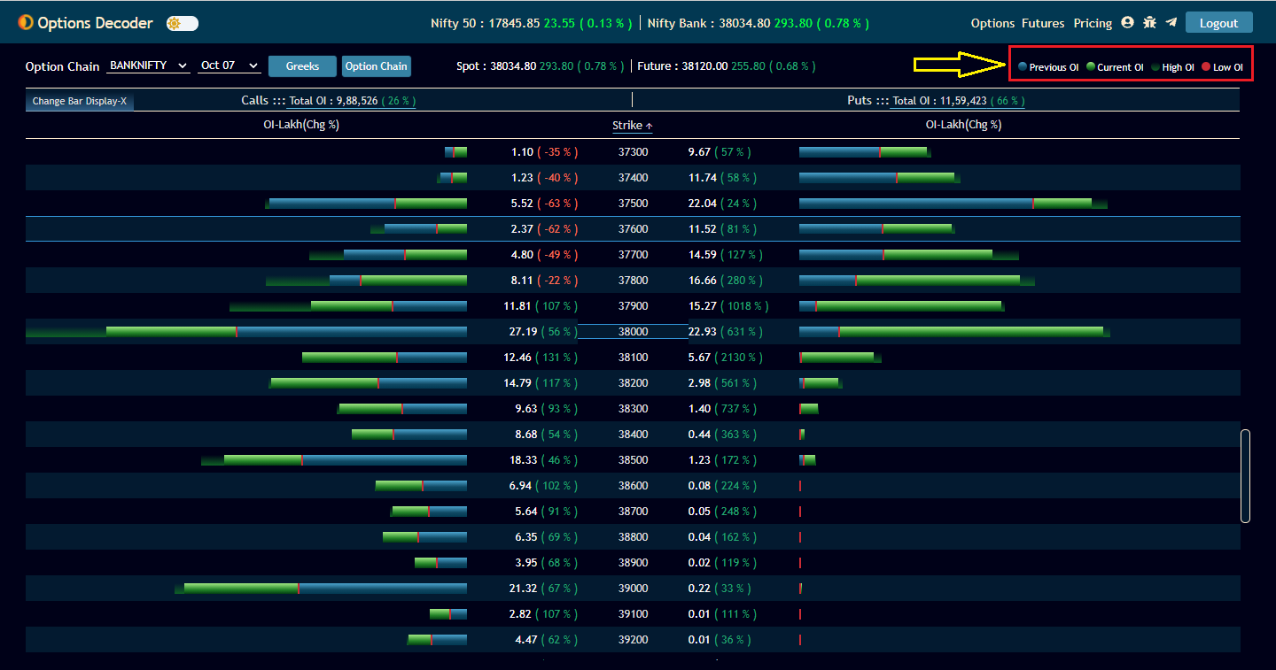

Slide 18
OI Graph
Simple bar representation of current OI and OI Change.
Select 7 or 14 or 21 strikes above and below the ATM.
Switch the color of call and put
View 2- current or last 3,5,6,10,15,30,60 mins change in OI.

Slide 19
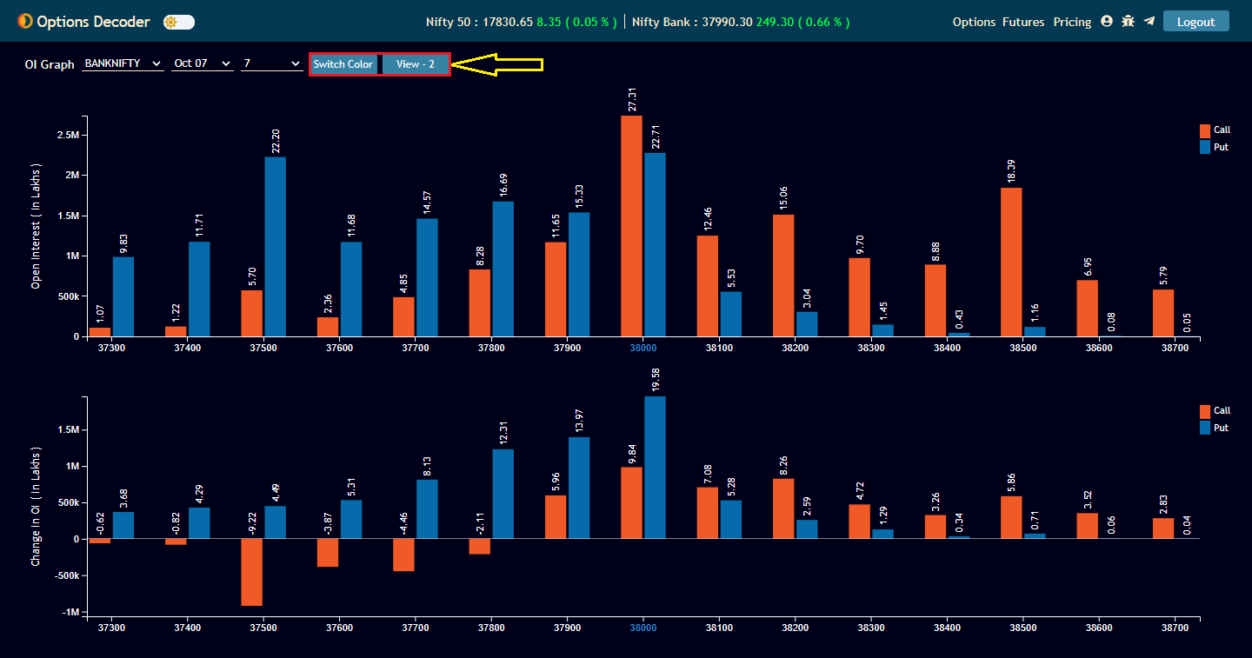

Slide 20
OI Change
Data in tabular form
Analyze OI change, OI change %, Price change based on current or previous time.
3/6/15/30/60 min time intervals
Analysis - Long build, Short build, Long unwind, Short cover

Slide 21
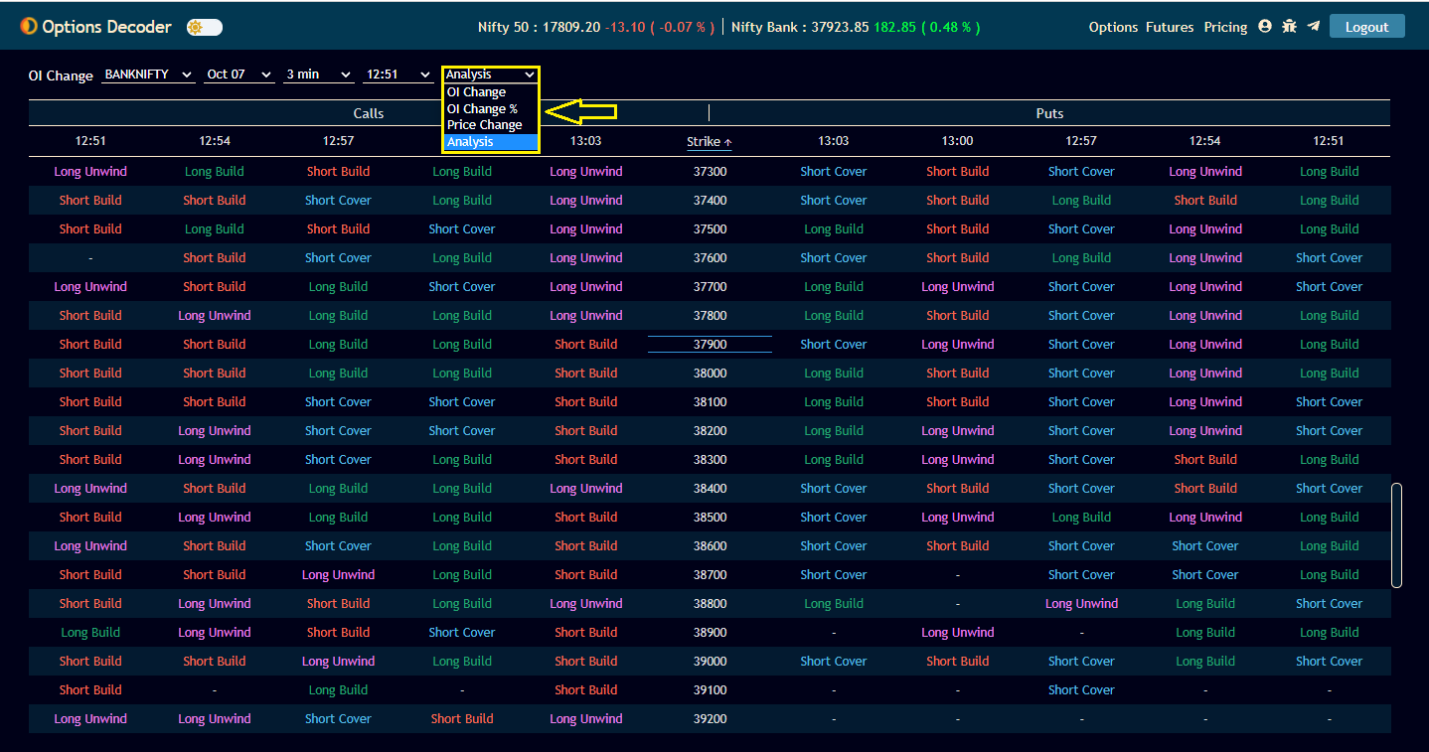

Slide 22
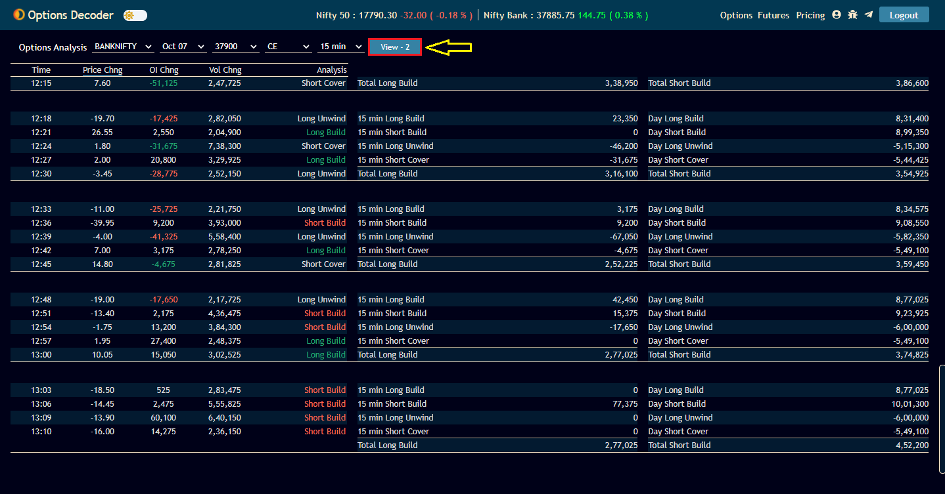
Option Analysis
Analyze all the options with OI change, Price change, Volume change and the interpretation

Slide 23
PE-CE Difference
PE - CE difference of OI or Change in OI with chart.
Automatic ATM update with respect to the spot price.
Future OI, LTP and Analysis. Yellow arrow - LTP above VWAP.
Click on the color legend (below graph) to select or deselect lines.
Blue color background on table - High OI , Violet color background on table - Low OI
Green arrow indicates the current OI Trend bar strength increased. Red arrow indicates the current OI Trend bar strength decreased

Slide 24
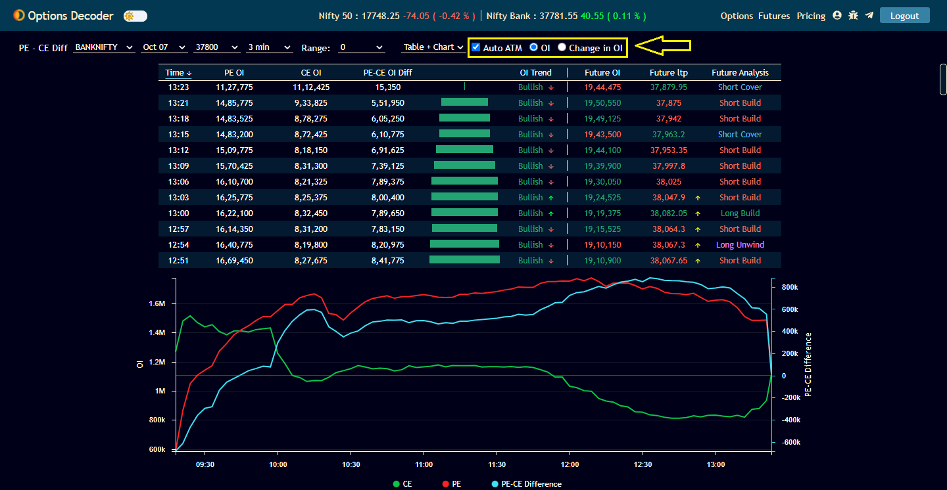

Slide 25
Multi Strike Chart
Plots OI, OI change, Price , Volume , Greeks and IV of multiple strikes
Straddle chart
Upto 5 strikes of CE and PE in single chart

Slide 26
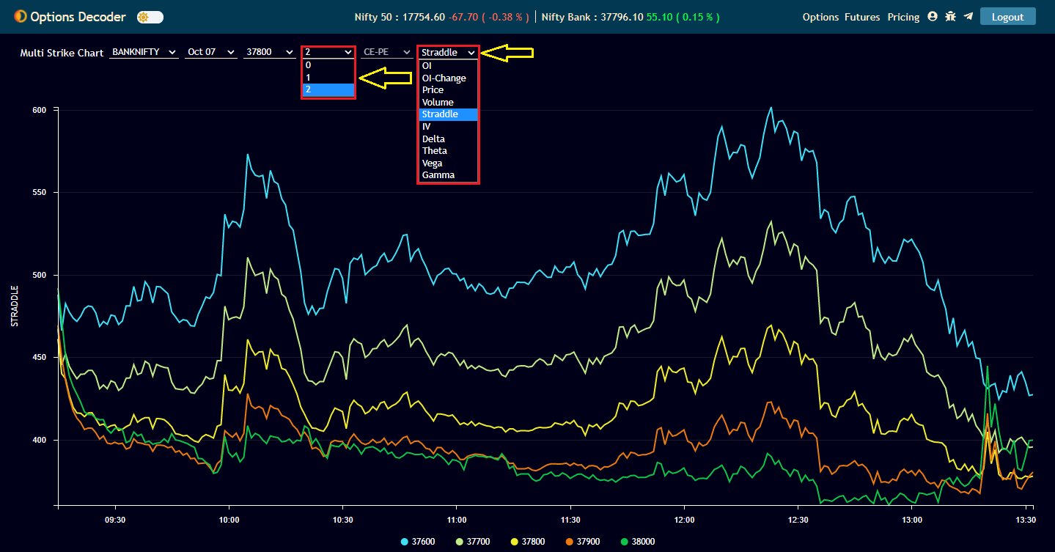

Slide 27
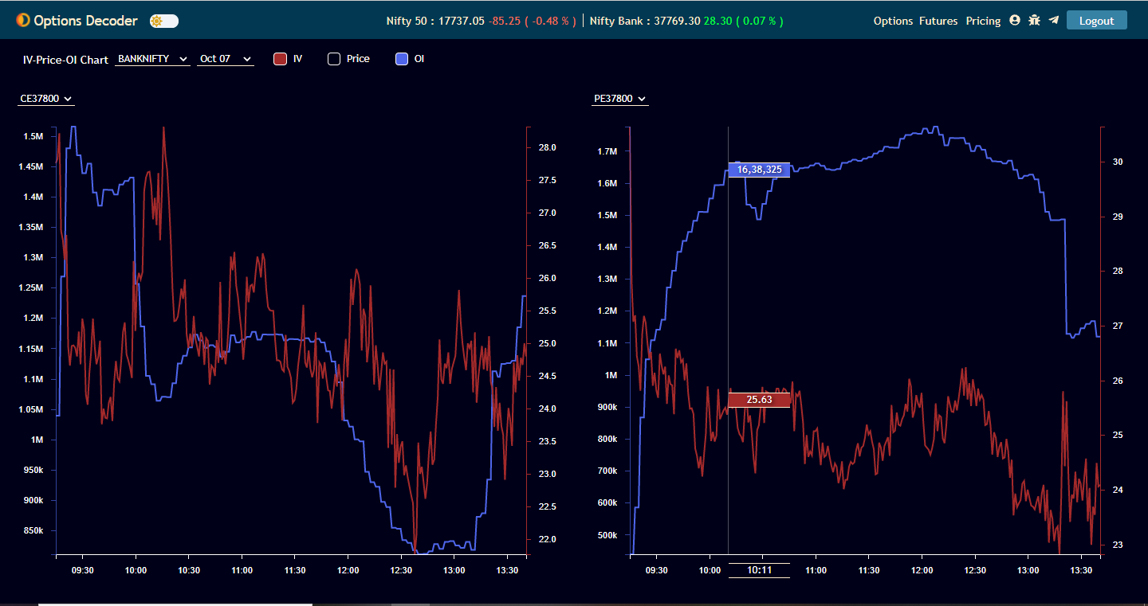
IV-Price-OI chart
Any 2 Graphs can be viewed at a time.

Slide 28
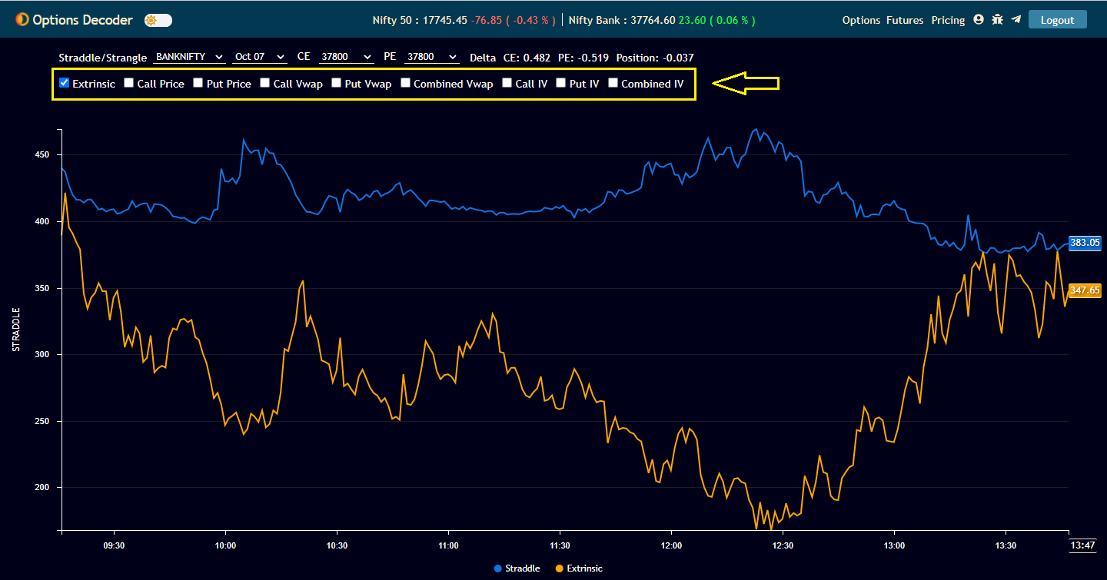
Straddle/Strangle
Plot extrinsic, Call Price, Put Price, Call IV, Put IV, Combined IV, Call Vwap, Put Vwap, Combined Vwap.

Slide 29
Strategy Builder
Create your own strategies.
Trade directly form strategy builder.
Analyze trades and positions.
Strategy builder, Payoff chart, Payoff details, Position details in a single view.
Greeks of total position and IV of each strike.
Live P&L of each strike & position.
Save strategy in your local machine and in cloud.
Live combined price chart of all selected strike prices in the strategy builder.

Slide 30
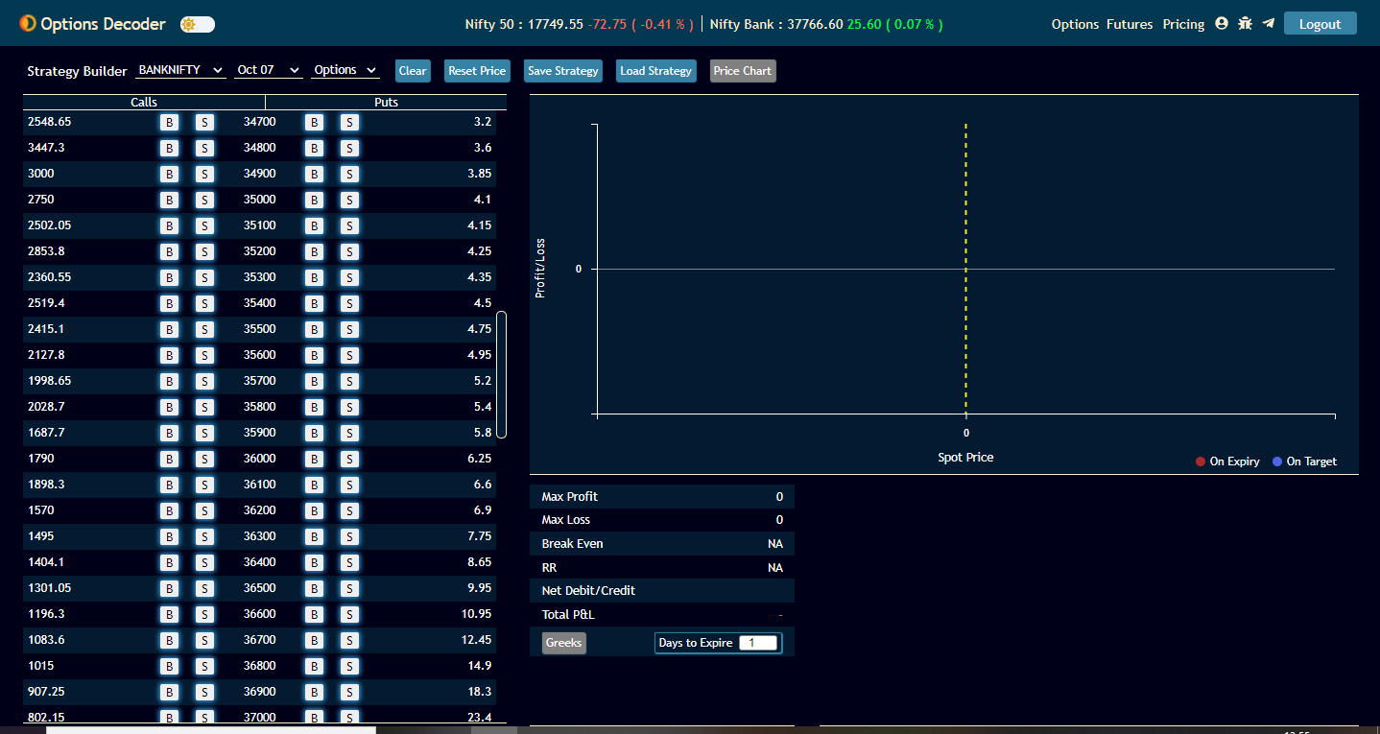

Slide 31
Strategy Analyzer
Select multiple strategies using checkbox on the left
Click on payoff diagram on top right to view payoff details.
Can see all checked strategies from the dropdown.

Slide 32
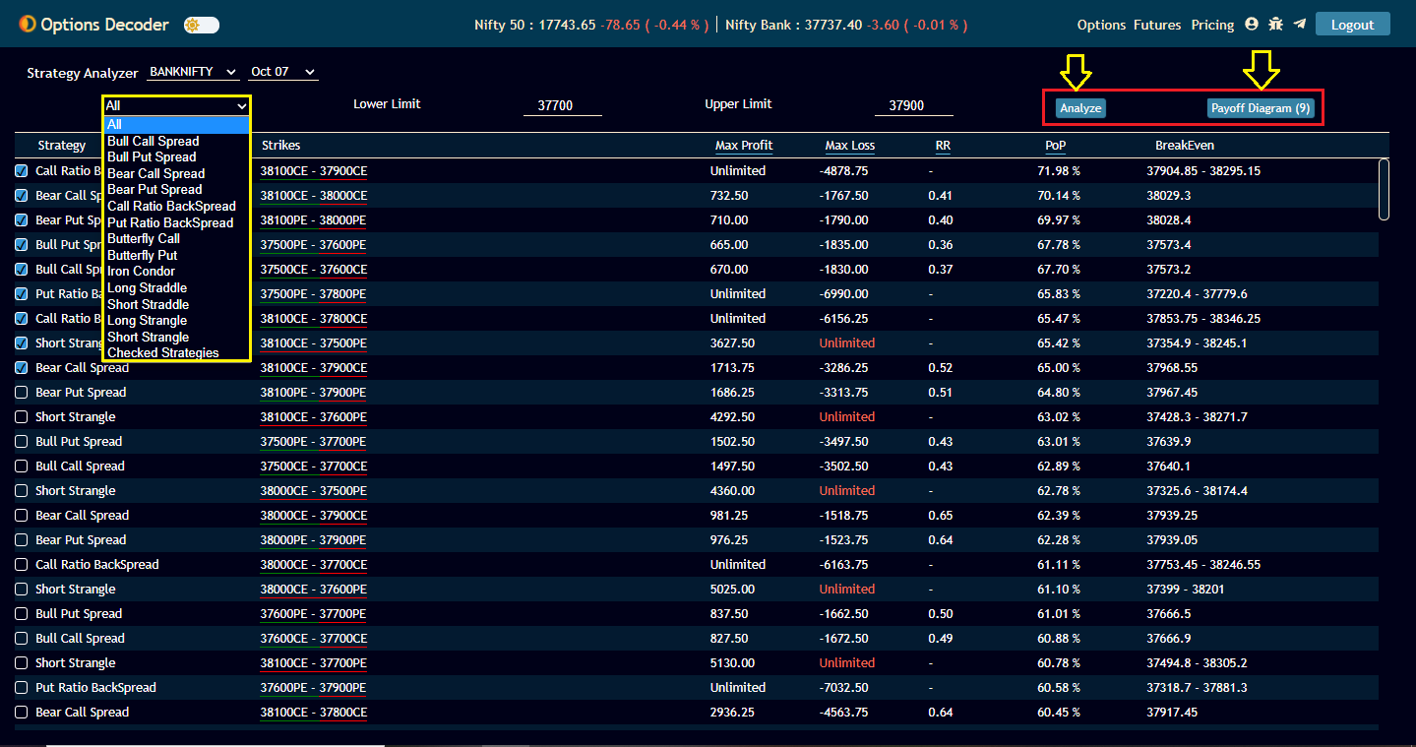

Slide 33
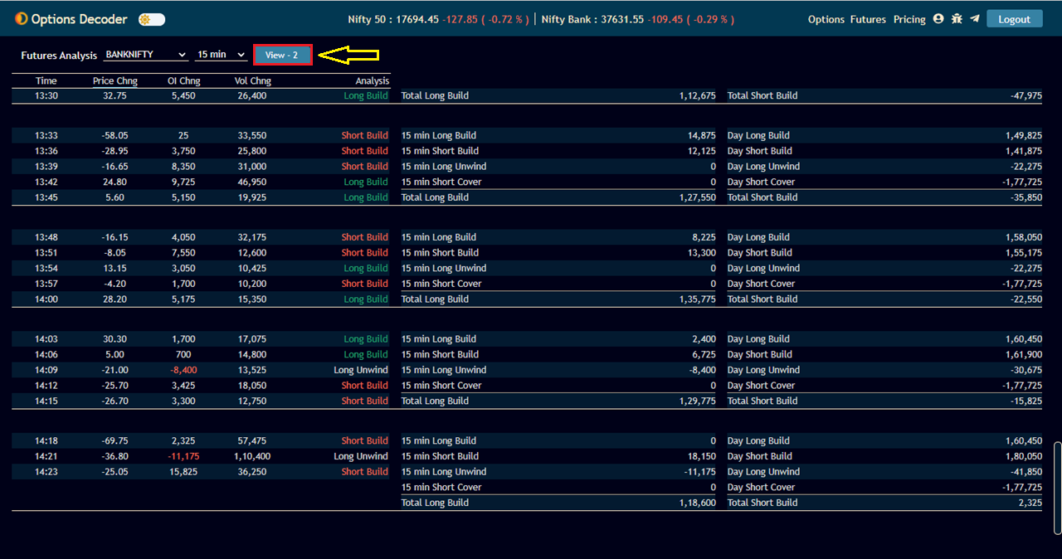
Future Analysis
Analyze all the futures with OI change, Price change, Volume change and the interpretation.

Slide 34
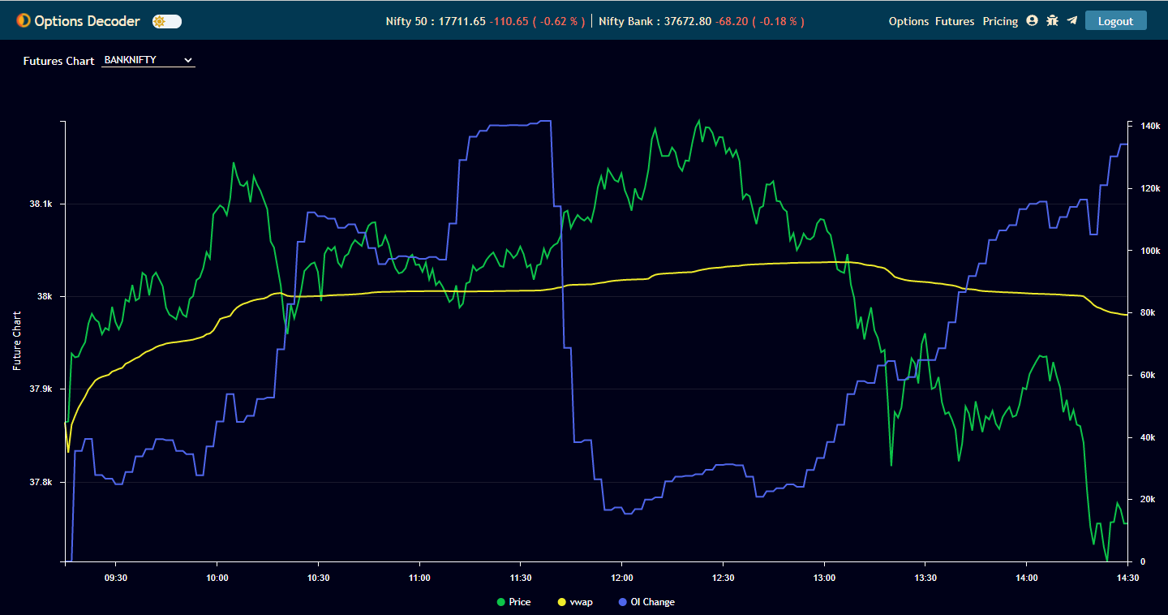
Futures Chart
Plot price, vwap and oi change

Slide 35
Top Futures
Easily identify the top futures of the day
Filter with Top price gainers and losers, Top OI gainers and losers , Top volume gainers.

Slide 36
Advance/ Decline
Data of sector-wise Advance/Decline.
Stock name with yellow color indicates the stock is trading above VWAP.
Sort stocks of all sectors together based on price%, oi %, volume%

Slide 37
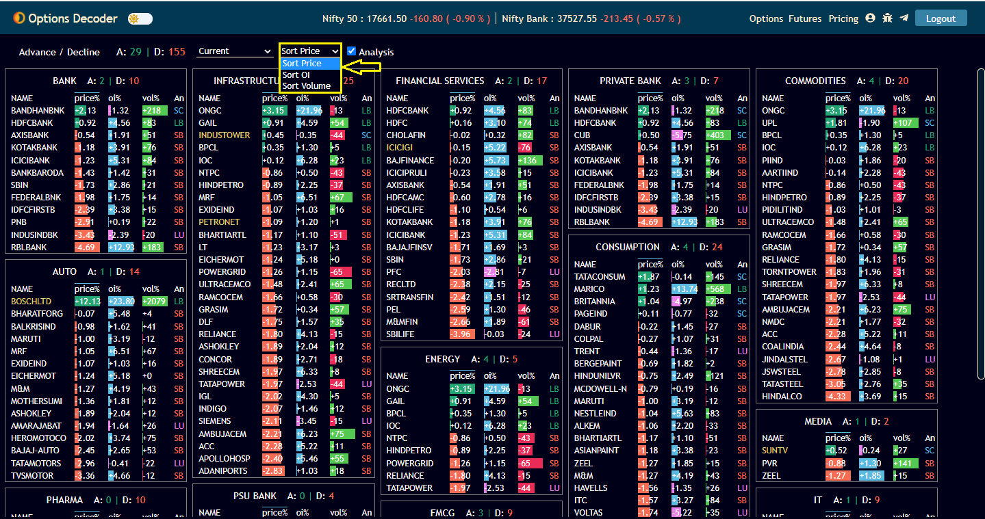

Slide 38
Watchlist
All futures and sector-wise data.
Top weightage Nifty50 and Nifty Bank.
Sort based on Price %, OI%, vol%.

Slide 39
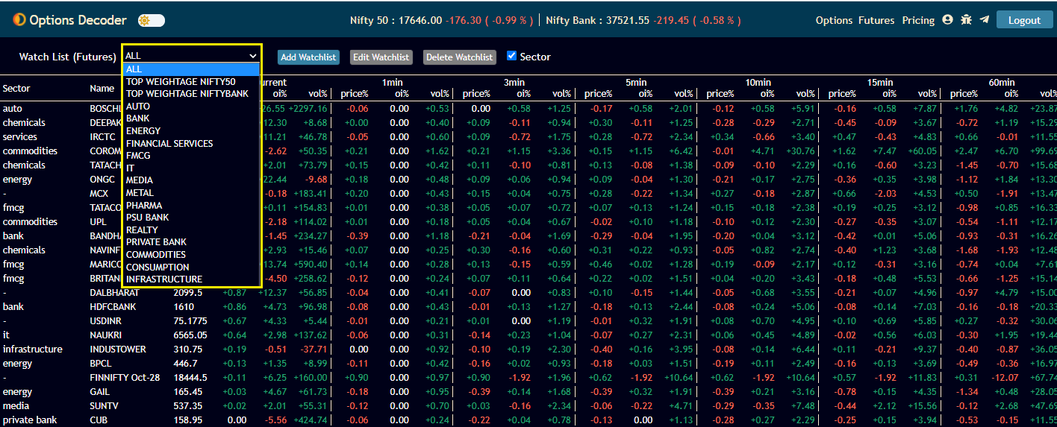

Slide 40
HV-IV
Plot historical volatility and implied volatility.
Select day range for the historical volatility.

Slide 41
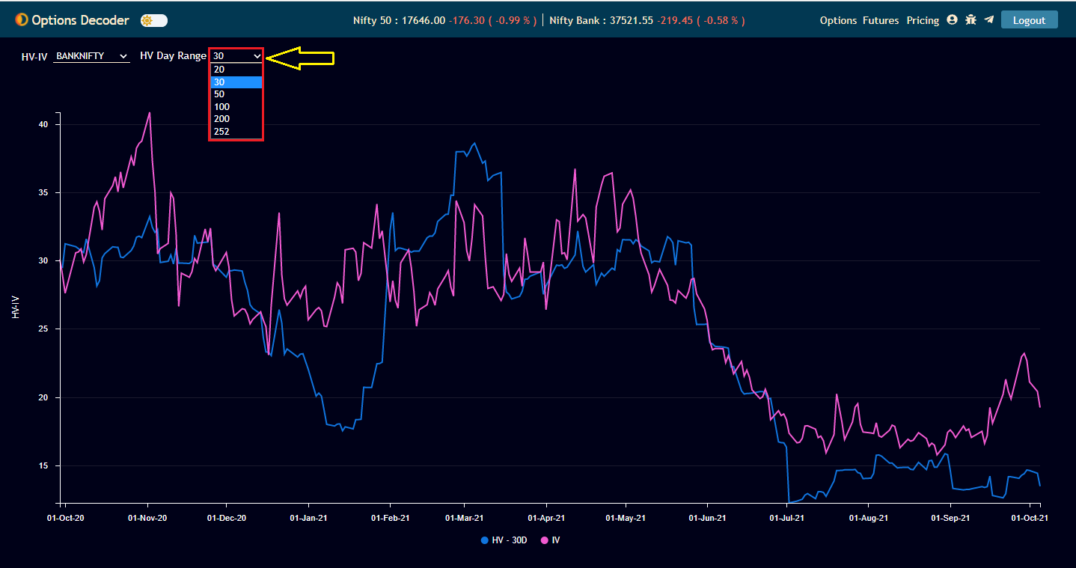

Slide 42
How to Connect to Fyers from TrueData Options Decoder.
Step 1> After logging into TrueData Options Decoder, go to Broker Login for logging into Fyers.

Slide 43
Step2:- Click on the Fyers Logo.

Slide 44
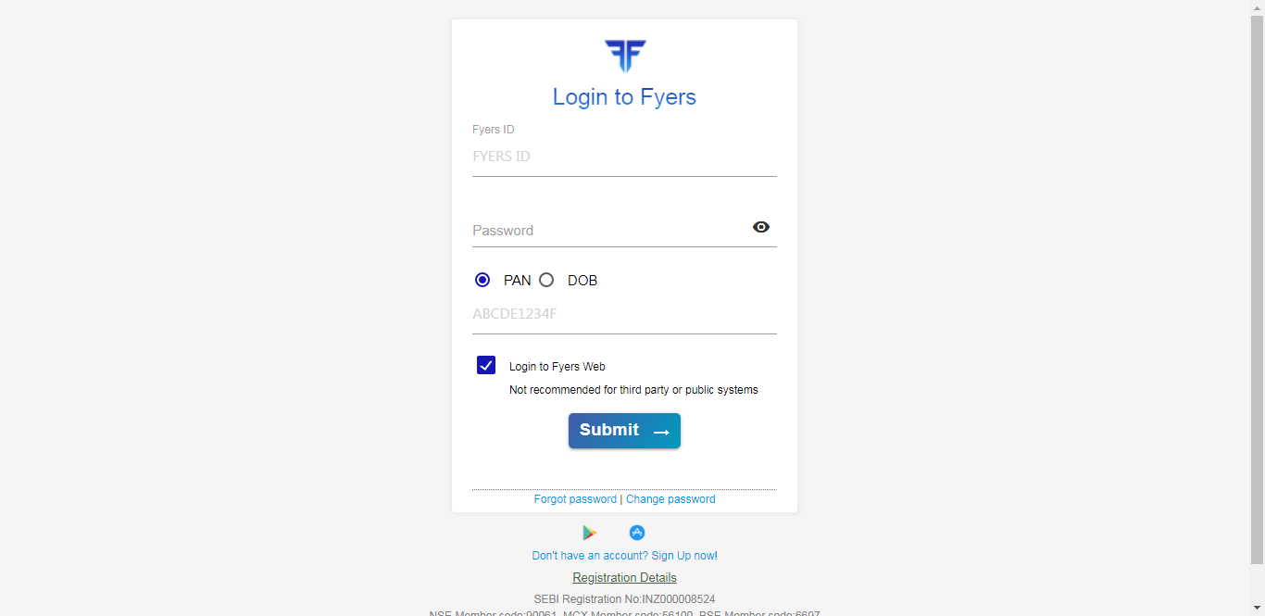
Step:- 3 Login to Fyers

Slide 45
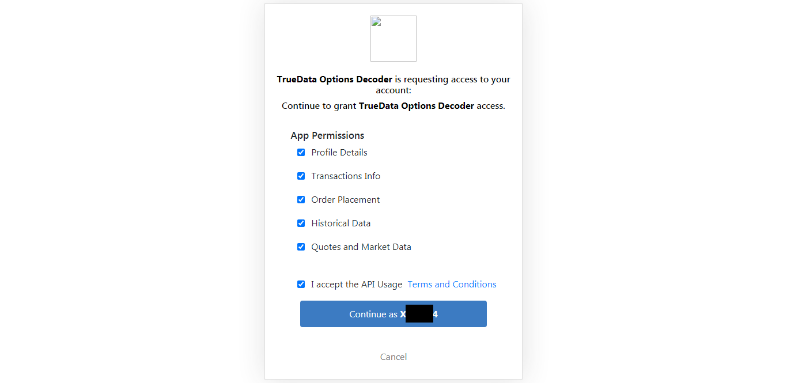
Step4:- Give App permissions and continue.

Slide 46
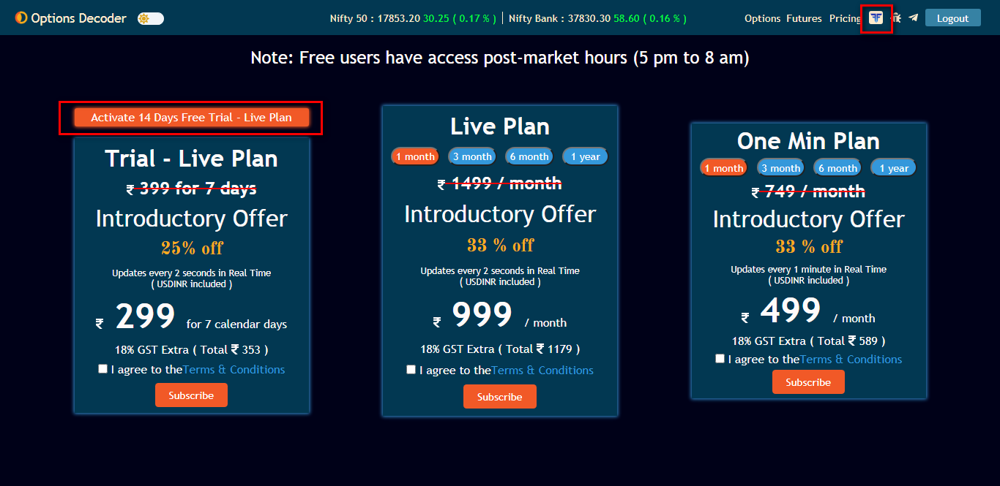
Step 5:- Successful broker login will redirect to pricing page. Click on 'Activate 14 Days Free Trial - Live Plan' button to activate the free trial.

Slide 47
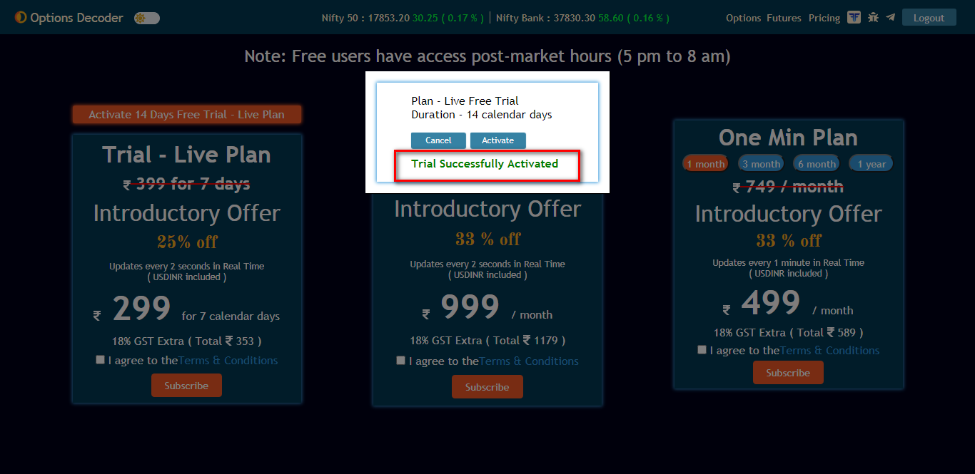
Step 6:- Click Activate button on the confirmation window.

Slide 48
Step 7:- After successful Trial activation it will redirect to option chain page
Step 8:- In option chain page hover on LTP column to view Buy & Sell button
Step 9:- Click on B or S button for the order window and trade

Slide 49
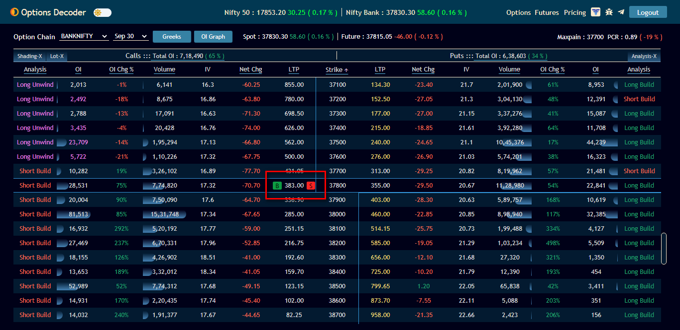

Slide 50
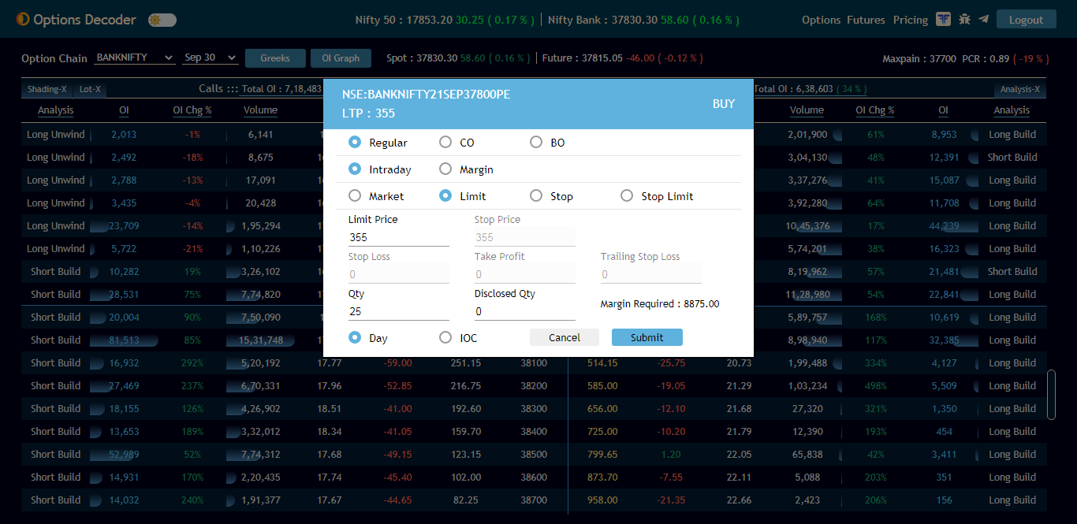

Slide 51
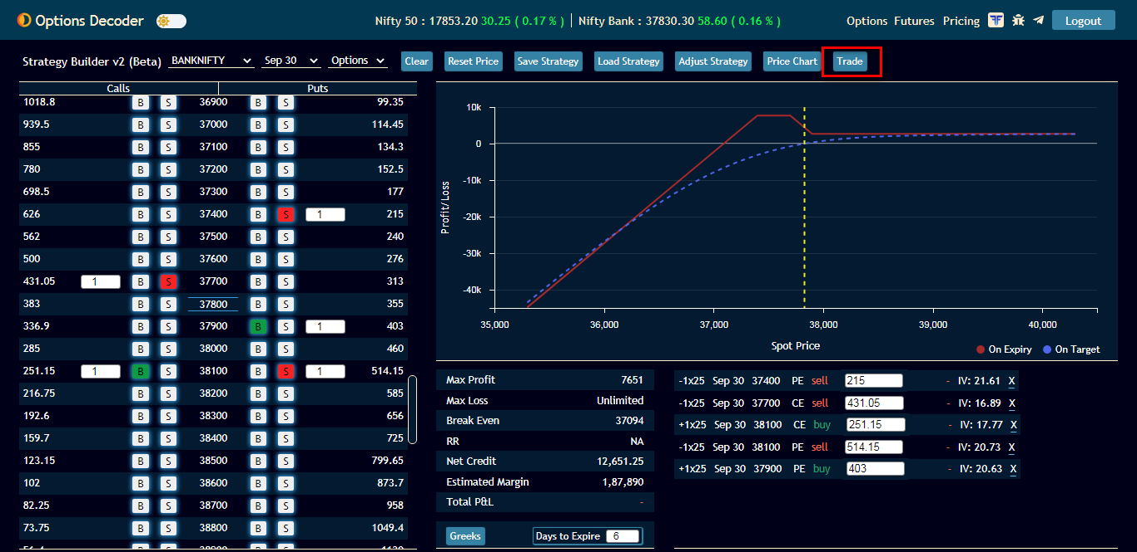
Step 10:- Go to Strategy builder page. Select strikes for a strategy and click on 'Trade' button

Slide 52
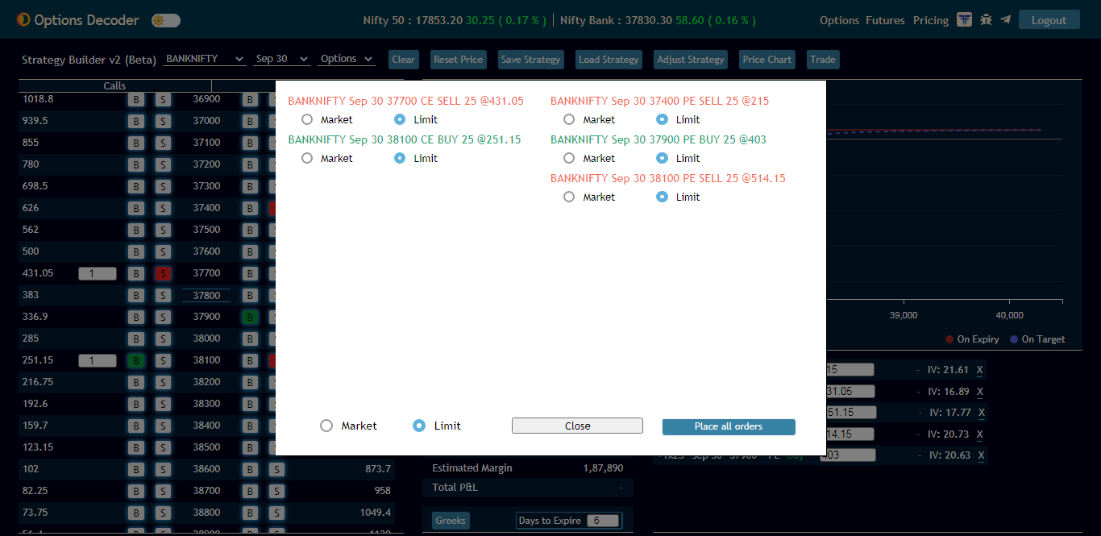
Step 11:- Order window will open and place order.

Slide 53
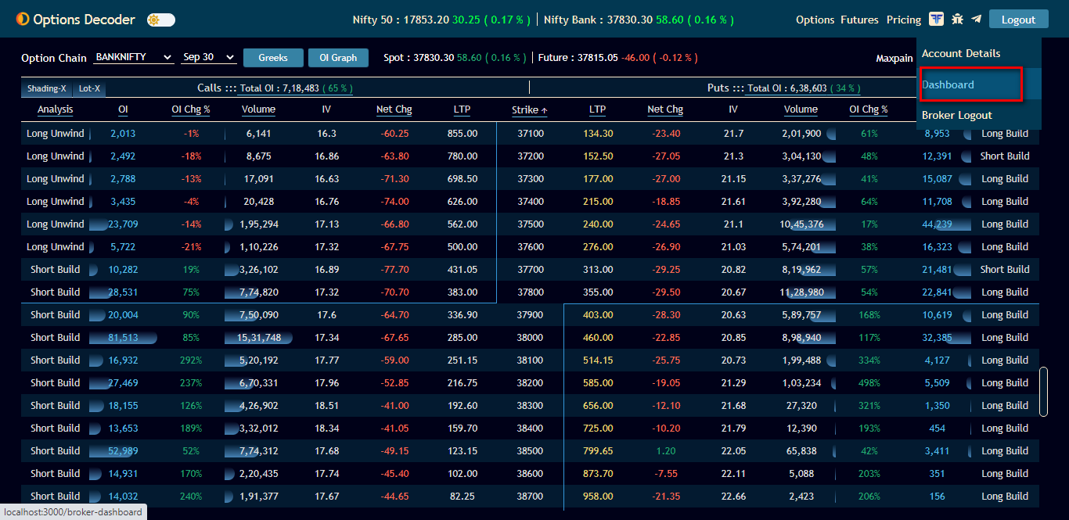
Step 12:- Go to Dashboard link to view all the trade details

Slide 54
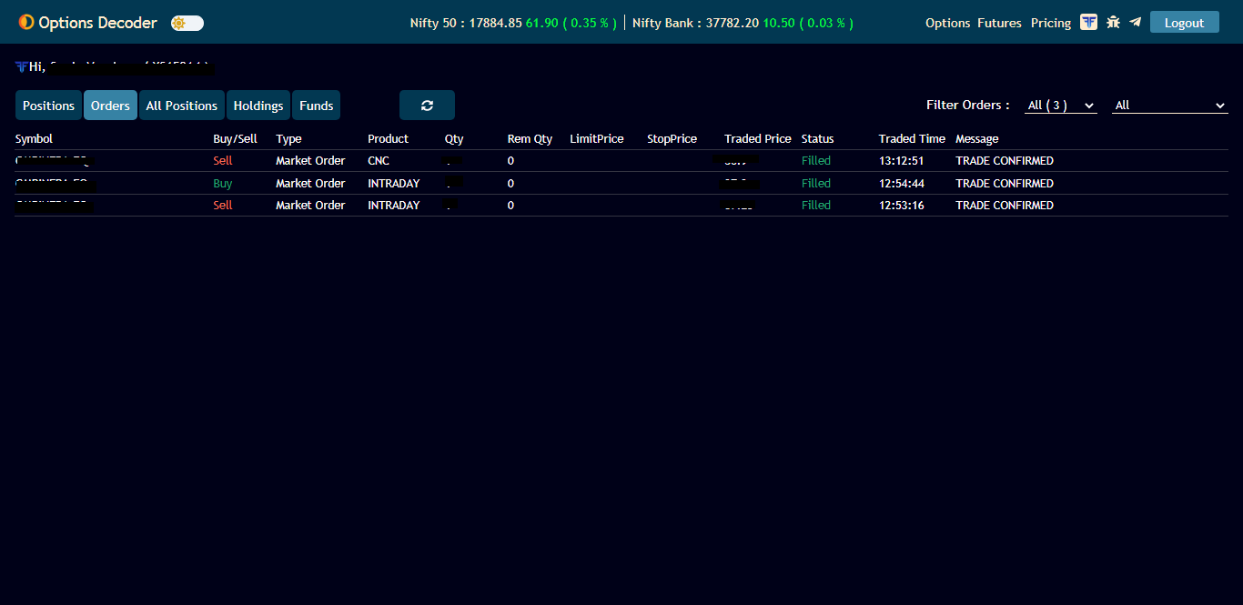
Step 13:- In dashboard , you can view Positions, Orders, All Positions, Holdings, Funds.

Slide 55
Special Benefits for Fyers client through TrueData Options Decoder
Now , execute trades directly from your favorite Future and Options analysis platform.
TrueData Options Decoder is now integrated with Fyers, one of the best discount broker in India.
Using TrueData Options Decoder , you can analyze and execute single or multiple orders directly from one place
Our Live data plan with 2 seconds real time update helps you to analyze trades quickly and make better trading decisions.
All Fyers client will get a 14 Days Free Trial - Live Plan

Slide 56
Thank You

